Slide 1



Project Module 3 Features extraction
Bahnisikha DUTTA
Mathieu LAPEYRE
Palash Shastri
ECE6780
Spring 2016, Professor May D. Wang

Slide 2
Objective
Ultimate Goal: Cancer Clinical Decision Support enabled by Medical Image Processing of Histopathological Images
Previous Goals (Modules 1,2)
Image Segmentation
Feature Extraction
Current Goals (Module 3)
Image classification
Prediction modelling

Slide 3
Workflow Diagram
Original image
Module 1
Module 3
Literature Review,
Normalization, Segmentation,
Feature Extraction/Selection,
Classifiers training,
Cross-Validation
Color Normalization
Literature Critique
Segmentation
Performance Evaluation
Training set
Train classifiers
Segmented image
Literature Review,
Performance metrics(all),
Feature Extraction,
Dimensionality Reduction
GUI implementation
Cross-Validation
Performance metrics
Module 2
Color-based feat. extraction
Texture-based feat. extraction
Predictive model
Shape-based feat. extraction
Literature Review,
Segmentation,
Feature Extraction/Selection,
Classifiers training,
Cross-Validation
Feature selection
Testing set
Dimensionality reduction
Validate model
Image features
Classification result

Slide 4
literature critique
 | Strategies | Papers | Location | Strength/Weakness | Selected
Normalization | Reinhard’s Method CDV-L CDV-MM Colormap Normalization | Hoffman et al 2014 Reinhard et al 2001 Magee et al. 2009 | University of UTATH, IEEE Computer Graphics and Application Journal. University of Leeds, MICCAI Workshop. | Weakness: 1)highly dependent on reference batch selection 2)First two approaches introduces high background color distortion Strengths: Easy and efficient algorithms | Our own method: Statistical Colormap Normalization Rationale: Does not require manual selection of reference image/ batch. Does not produce background artifacts
Supervised | LDA classification, LDA reclassification in sample color space Supervised grayscale conversion, learning based marker detection and classification, watershed segmentation Bayesian/kNN/ SVM training, Color watershed | Kothari et al. 2011 Mao et al. 2006 Meurie et al. 2003 | Journal of the American Medical Informatics Association. IEEE Transactions on Biomedical Engineering Journal. Signal Processing and Information Technology Journal. | Weakness: 1)Highly dependent on ground truth selection 2)Requires a lot of manual effort and time 3)Training classifiers takes significant time Strengths: Produces better segmented results than unsupervised | LDA classification followed by Level Set method Rationale: fast, worked well for small reference dataset
Notes:
Split the table into 2 slides if reqd
Explain what exists, what is lacking, by who and when
+ one summary table to summarize literature critique to assess strength/weakness of methods
WHAT you researched and learned, and WHY you picked up these methods

Slide 5
literature critique
 | Strategies | Papers | Location | Strength/Weakness | Selected
Unsupervised | Hierarchical Self-Organizing Map EM algorithm with the Fisher-Rao criterion as its kernel K-means clustering in the La*b* color space Kernel graph cut | Datar et al. 2008 Jun et al. 2007 Sertel et al. 2009 Salah et al. 2011 | IEEE International Symposium on Biomedical Imaging. IEEE Transactions on Image Processing. J. Signal Proc.. Systems Journal. | Weakness: 1) Lack of in-depth prior knowledge for the segmentation task 2) Heavily rely on strong assumptions on data distribution, e.g. Gaussian | K-Means followed by Kernel Graph Cut Method Rationale: K-means generates good initial segmentation fast; Kernel Graph Cut perform well generally (better than traditional Graph Cut)
Performance Evaluation | Foreground/Background variance Rand Index Squared color error Entropy based evaluation | Unnikrishnan et al. 2007 Zhang et al. 2008 Wagner et al, 2007 Chabrier et al. 2004 Yang et al. 2007 Ouattara et al., 2011 | IEEE Transactions on Pattern Analysis and Machine Intelligence. Computer Vision and Image Understanding Journal. Cranio-Maxillo-Facial Surgery Journal. Asian Journal of Scientific Research. | Weakness: 1) Rely on strong assumption on the distribution. Can lead to negative value. 2) Many foreground/background evaluation. 3) Features error (color, texture, …) on the overall region instead of region boundary. | Supervised : Clusters similarity with Rand Index. Unsupervised : individual per-region measures, weighted by boundary length and region size (Zeb).
Notes:
Split the table into 2 slides if reqd
Explain what exists, what is lacking, by who and when
+ one summary table to summarize literature critique to assess strength/weakness of methods
WHAT you researched and learned, and WHY you picked up these methods

Slide 6
literature critique
 | Strategies | Papers | Location/Time | Strength/Weakness | Selected
Color Features | Histograms bins in r,g and b channels | Gurcan et al Tabesh et al | IEEE Rev Biomed Eng, vol. 2, pp. 147-171, 2009 IEEE Transactions on Medical Imaging, vol. 26, pp. 1366-1378, 2007 | Batch Dependent | Color histograms in three color spaces: rgb,lab and hsv.
Shape Features | 8 statistics based shape feature vector distribution estimation | L. Bucheron (Phd Thesis) Gurcan et al | Phd Thesis, University of California, Santa Barabara, 2008 IEEE Rev Biomed Eng, vol. 2, pp. 147-171, 2009 | Effectively covers the important geometric statistics that enable unique identification of shapes Only an approximation of the distribution and not exact | 11 features- Area, Major Axis, Minor Axis, Eccentricity, Convex Area, Filled Area, Euler Number, Orientation, Solidity, Perimeter, Extent
Texture Features | GLCM GLRL Wavelet Fractal | Gurcan et al, R. M. Haralick et al Livens et al. | IEEE Rev Biomed Eng, vol. 2, pp. 147-171, 2009 Classification, IEEE Transactions on Systems, Nov. 1973 University of Antwerp, Belgium, 1997 | GLCM is fast and widely used. Wavelet and fractal are new but promising compared to Gabor (but can be computationally expensive). There was no significant amount of information for GLRL. | GLCM
Notes:
Split the table into 2 slides if reqd
Explain what exists, what is lacking, by who and when
+ one summary table to summarize literature critique to assess strength/weakness of methods
WHAT you researched and learned, and WHY you picked up these methods

Slide 7
literature critique
 | Strategies | Papers | Location | Strength/Weakness | Selected
Feature Selection | SD SFS/SBS SFFS RSFS MI | Gurcan et al Pohjalainen et al | IEEE Rev Biomed Eng, vol. 2, pp. 147-171, 2009 Computer Speech & Language, 2015 | Provides an overview of various feature selection techniques used in the literature SD and MI feature ranking techniques are very efficient and effective implementations | SD MI
Dimensionality Reduction | PCNA TSNE ICA LLE | Gurcan et al Roweis et al Van Der Maaten | IEEE Rev Biomed Eng, vol. 2, pp. 147-171, 2009 Science 290, 2000 Journal of Machine Learning Research 9, 2008 | PCNA is linear and easily computable TSNE is non-linear, easy to optimize and well suited for very high-dimensional data LLE preserves the local structure of data but not the global structure | PCNA TSNE
Notes:
t-Distributed Stochastic Neighbor Embedding
Explain what exists, what is lacking, by who and when
+ one summary table to summarize literature critique to assess strength/weakness of methods
WHAT you researched and learned, and WHY you picked up these methods

Slide 8
literature critique
Strategies | Papers | Location/Time | Strength/Weakness | Selected
Fisher Discriminant Analysis | ### | ### | ### | No
Support Vector Machine | ### | ### | ### | Yes
Neural Network | ### | ### | ### | Yes
K-nearest Neighbor | ### | ### | ### | Yes (best for Dataset1)
Decision Tree | ### | ### | ### | Yes
N-fold Cross Validation | ### | ### | ### | ###
Leave-one-out Cross-Validation | ### | ### | ### | ###
Performance Metrics | ### | ### | ### | ###
Notes:
Split the table into 2 slides if reqd
Explain what exists, what is lacking, by who and when
+ one summary table to summarize literature critique to assess strength/weakness of methods
WHAT you researched and learned, and WHY you picked up these methods

Slide 9
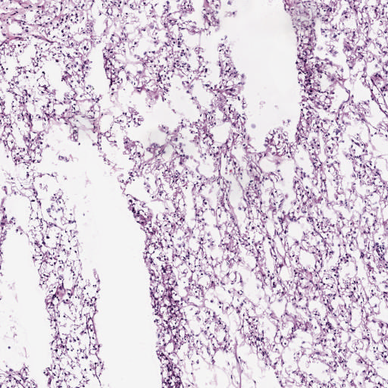
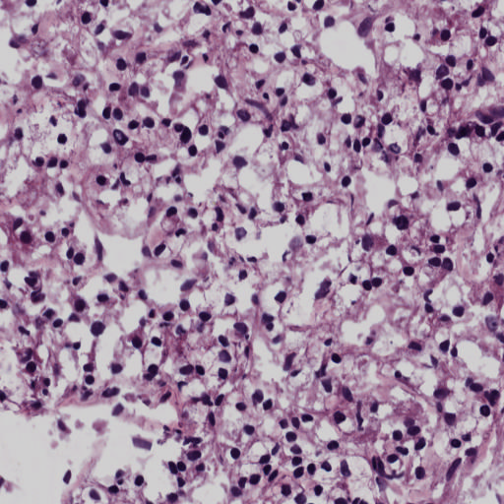
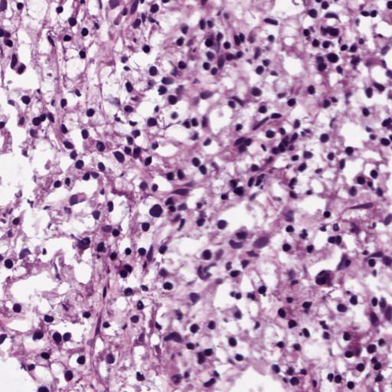
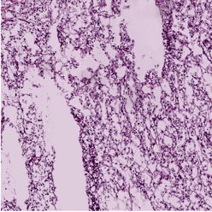
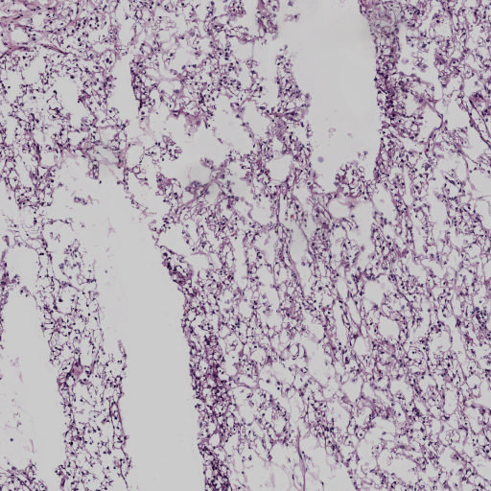
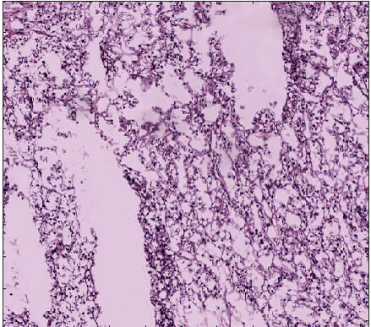
IMAGE Normalization
Batch (i1)
Colormap (i1)
Total unique colors (i1)/total no. of images in batch(n1)
Dataset 2/3
Mean, Std unique colors
Batch (i2)
Colormap (i2)
Total unique colors (i2) /total no. of images in batch(n2)
Batch (ik)
Source
Total unique colors (i3) /total no. of images in batch(nk)
Colormap (ik)
Both Source and Target normalized to a base color map
Total unique colors (iS)/No. of images
in the batch after outlier detection
Source image batch
Colormap iS
Within one std of mean
Not within one std of mean
Reinhard
Target
Map to mean color map
Map to mean+-std color map
Rather than using Reference image/batch for finding target colormap, we use the mean color map across a dataset
CDV-L

Slide 10
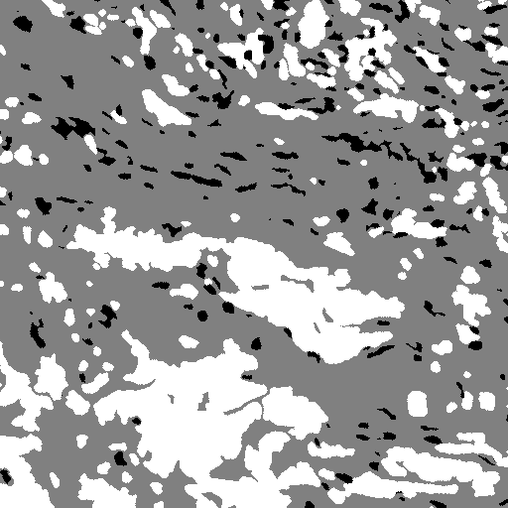
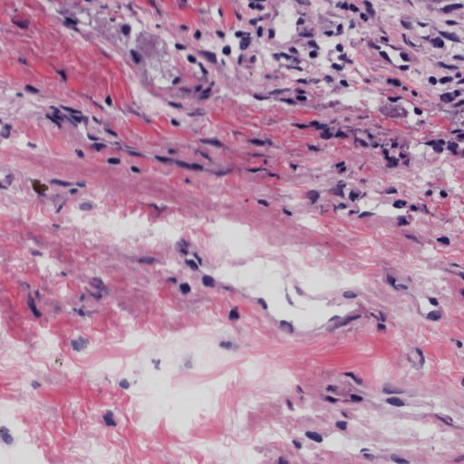
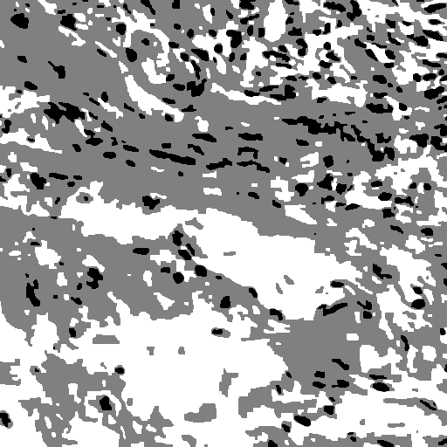
SEgmentation
Supervised:
Preparation of Ground Truth using Manual Segmentation: ~10% of each Dataset
Each Ground truth images were then splitted into the 9:1 ratio
for preparation of training and testing set
LDA classifiers were trained on the training dataset and tested on others
The best performing classifier was used to segment the images
Level Set algorithm was used to smooth out the segmentation result.
Supervised image
Reference image
Unsupervised image
Unsupervised:

Slide 11
Available features
STATISTICS
1728 computed features.
Top 100 selected with Statistical Dependency and Mutual Information.
Reduced with PCA and t-SNE
144 color based features
264 shape based
1320 texture based
Texture features
Autocorrelation
Contrast
Correlation
Cluster Prominence
Cluster Shade
Dissimilarity
Energy
Entropy
Homogeneity
Maximum probability
Sum (variance, average, …)
Difference (variance, entropy, …)
Information measure of correlation
Inverse difference moment
Shape Features
Area
Major Axis
Minor Axis
Eccentricity
Orientation
Convex Area
Solidity
Filled Area
Euler Number
Extent
Perimeter
Color Features(16bin histogram)
Red Channel
Green Channel
Blue Channel
L Channel
A Channel
B Channel
Hue Channel
Saturation Channel
Value Channel
Notes:
Conversion to YCbCr space
Removal of white pixels by thresholding at 222 in the luminance(Y) space
Color Histograms with 16 bins in 3 color spaces: RGB, LAB, HSV
Shape features form the basis of low-level object understanding
Shape features gives you geometric information that is unique to that object
Extracted for each stain separately
Easily computable textural features based on GLCM and Fractals
Applied to stained images
Computed with different displacement and orientation values.

Slide 12
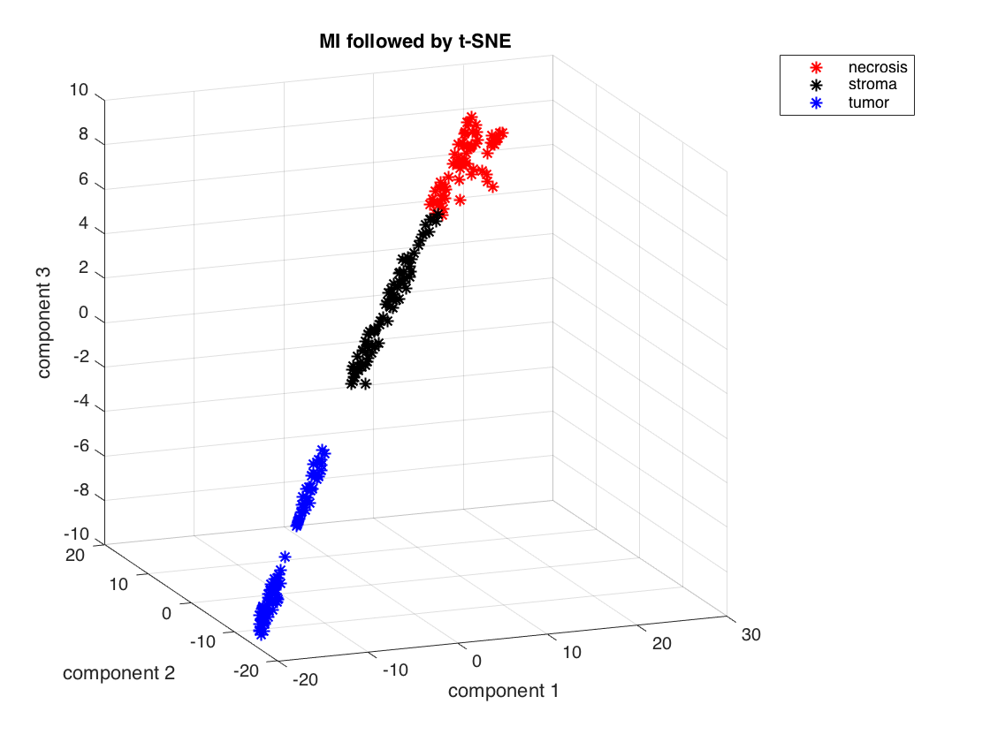
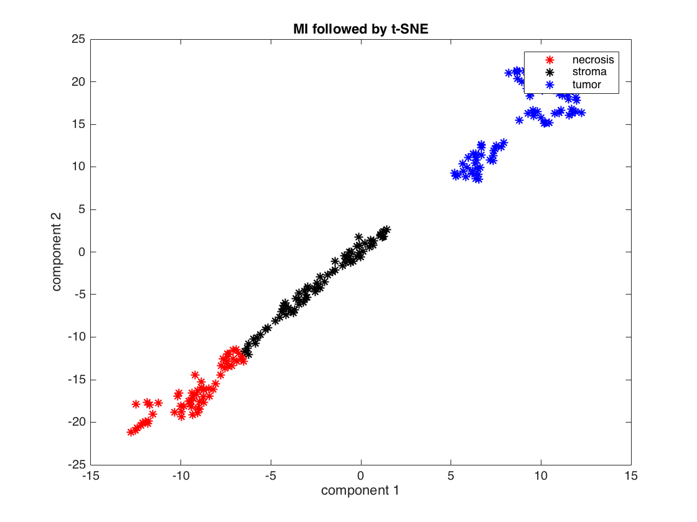
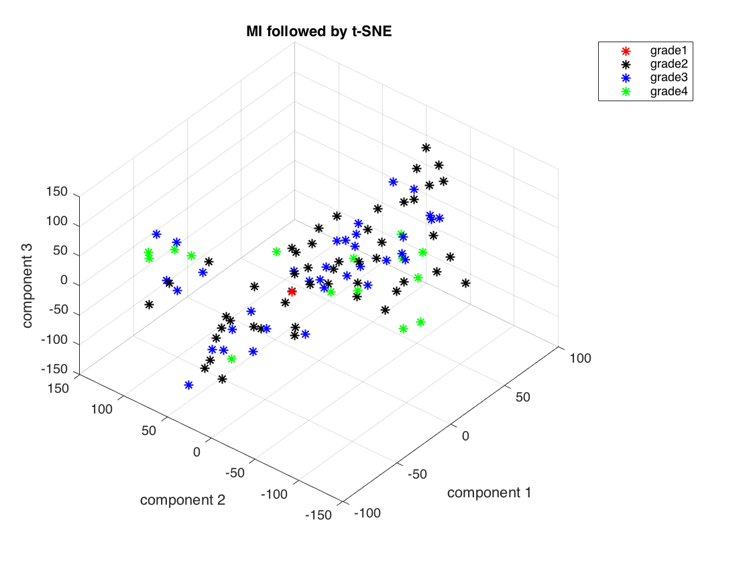
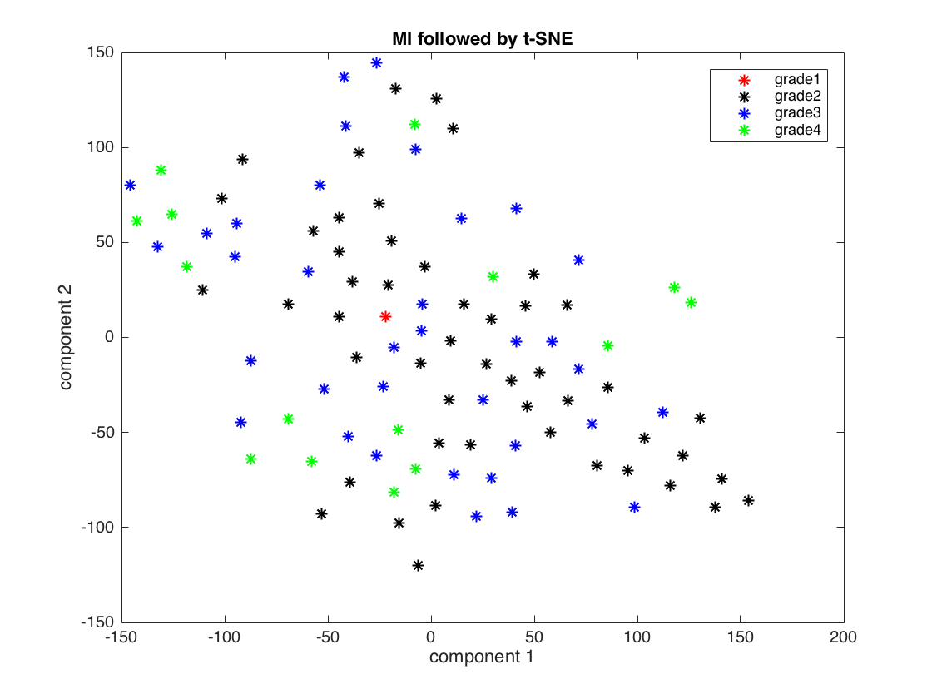
Reduced Feature PLots
Dataset1
Dataset2

Slide 13
Performance
Classifier | Dataset1 | Dataset2 | Dataset3
kNN
Random Forest
Neural Network
SVM
Percentage Accuracy for Different Classifiers (Best Model Fit after Cross Validation)
Classifier
kNN
Random Forest
Neural Network
SVM
Various Metrics for Different Classifiers

Slide 14

Appendix
SLIDES

Slide 15
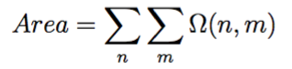
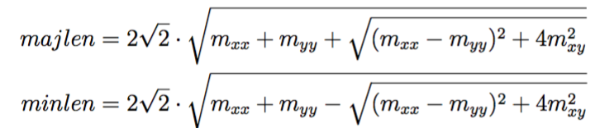
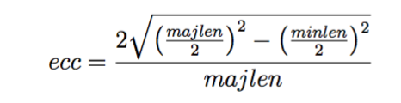
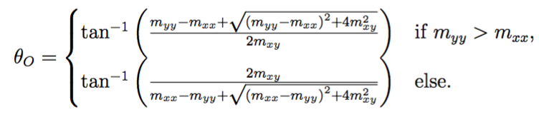
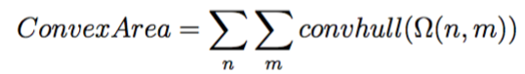
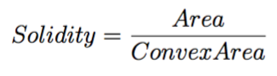
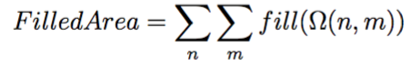
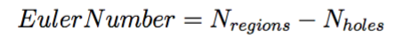
Features extraction
Shape-based extraction
Where omega(n,m) is the object mask, mxx and myy indicate second moments of x and y
Mathematical formulation of shape features-
Area -
Major Axis -
Minor Axis -
Eccentricity -
Orientation -
Convex area -
Solidity -
Filled Area -
Euler Number –

Slide 16
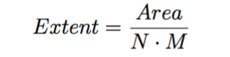
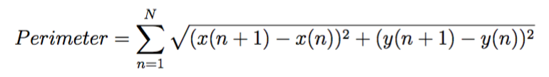
Features extraction
Shape-based extraction
Mathematical formulation of shape features-
10. Extent -
11. Perimeter -
Link

Slide 17
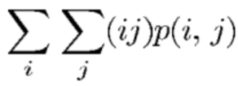
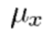
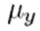
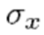
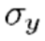
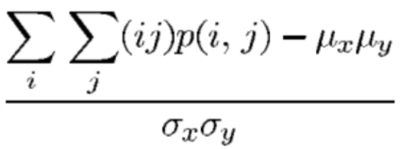
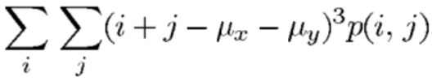
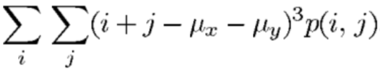
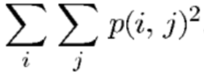
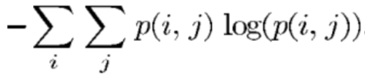
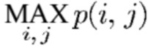
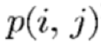
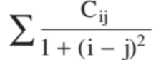
TEXTURE-BASED extraction
Autocorrelation
Contrast
Correlation
Cluster Prominence
Cluster Shade
Dissimilarity
Energy (angular second moment)
Entropy
Homogeneity
Maximum Probability
Variance
Information measure of correlation
Inverse difference
Inverse difference moment
Where , , and are respectively the mean and the standard deviation of the rows and columns of the matrix p(i,j), which is the (i,j)th entry of the GLCM.

Slide 18
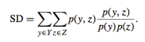
Features selection
Statistical Dependency(SD)
Measures dependency between features and the associated class labels
Larger the SD, more the dependency
Thresholding on the ranked features based on the SD weights
Followed by PCA

Slide 19
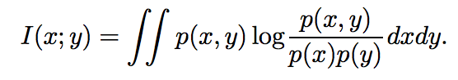
Features selection
Mutual Information/MI
Measures how much information the presence/absence of a term contributes to making the correct classification decision
Features ranked in descending order based on their mutuality
Above formulation shows an example for two random variables
Followed by PCA and t-SNE
Link

Slide 20
Dimensionality reduction
Two methods :
Principle Component Analysis (PCA)
Linear algorithm
Parameter free
t-Distributed Stochastic Neighbor Embedding
Non-linear machine learning algorithm
Relies on parameters (perplexity, early exaggeration, learning rate, number of iterations)
Particularly well-suited for high-dimensional dataset
Notes:
t-Distributed Stochastic Neighbor Embedding

